Slide 1


Sprint #1
Andrew Boothe, Vishak Vikranth, Colin Guzenda, Victoria Clavijo, Sonam Lama
CS495
Online Game Tournaments Website
TOURNAMENTS
LOGO HERE

Slide 2

The Overall Idea
Players upload their custom AI models into the online tournament site
The models are ran against each other
Based on the winner of 500+ simulated matches, one model moves on
The tournament winner is decided based on which model is the last model standing

Slide 3
Sprint #1 Goals
BEGIN
EARLY ON
CLOSING IN
END OF SPRINT
Start of Semester
January 30th
February 6th
February 18th
Getting introduced to our project.
Formulating ideas of how we should approach it
Built a basic mock bot
Docker setup testing for later on
Building the game logic
Uploading example AI scripts to front end
Completed the mock bot
Backend now simulates a tournament
Starting on Login
Finalizing Network Framework
Connecting front-end and backend

Slide 4
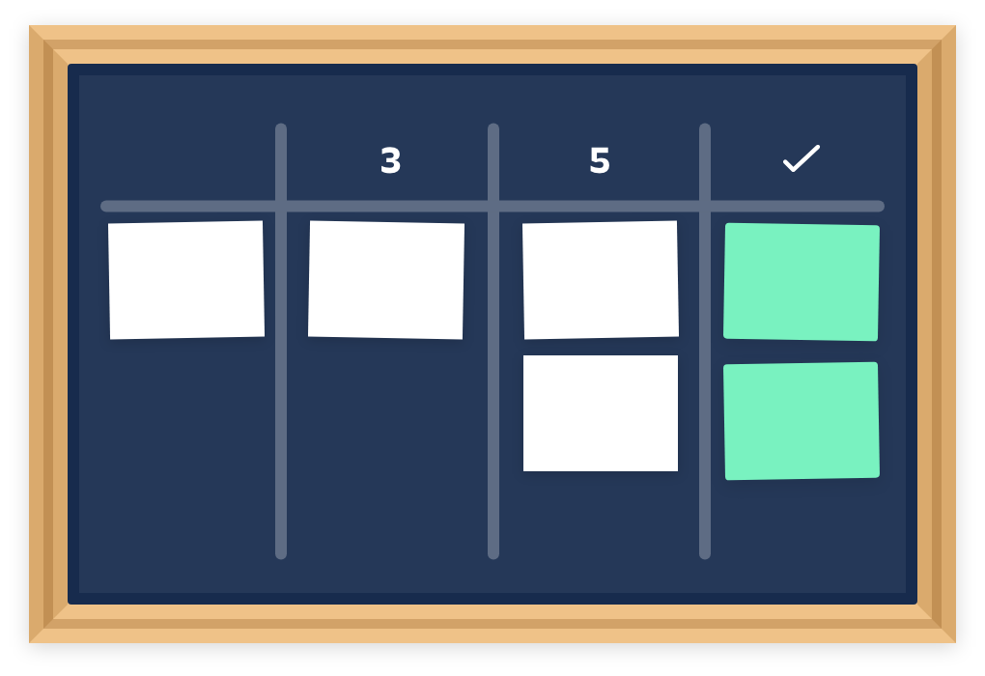
Project Backlog
User Authentication & Profiles
Matchmaking & Leaderboards
AI Opponent Mode
Battle Logs
Simulator Summary
Front-End Interactions
Real-Time Websockets
Multiple Docker Instances

Slide 5
Sponsor Feedback
GAMES
The current implementation, while functional, doesn't yet match the sponsor's vision of a simple drop-and-run tournament system, but we're moving in that direction.
SHIFT FOCUS
MULTIPLE FILES
WHAT’S NEXT?
Pivot from a 1v1 system to a large simulator; tournament-style
Should be able to drop a bunch of files in and they play each other
We listened to feedback and our current work heavily feeds into the shift in direction

Slide 6
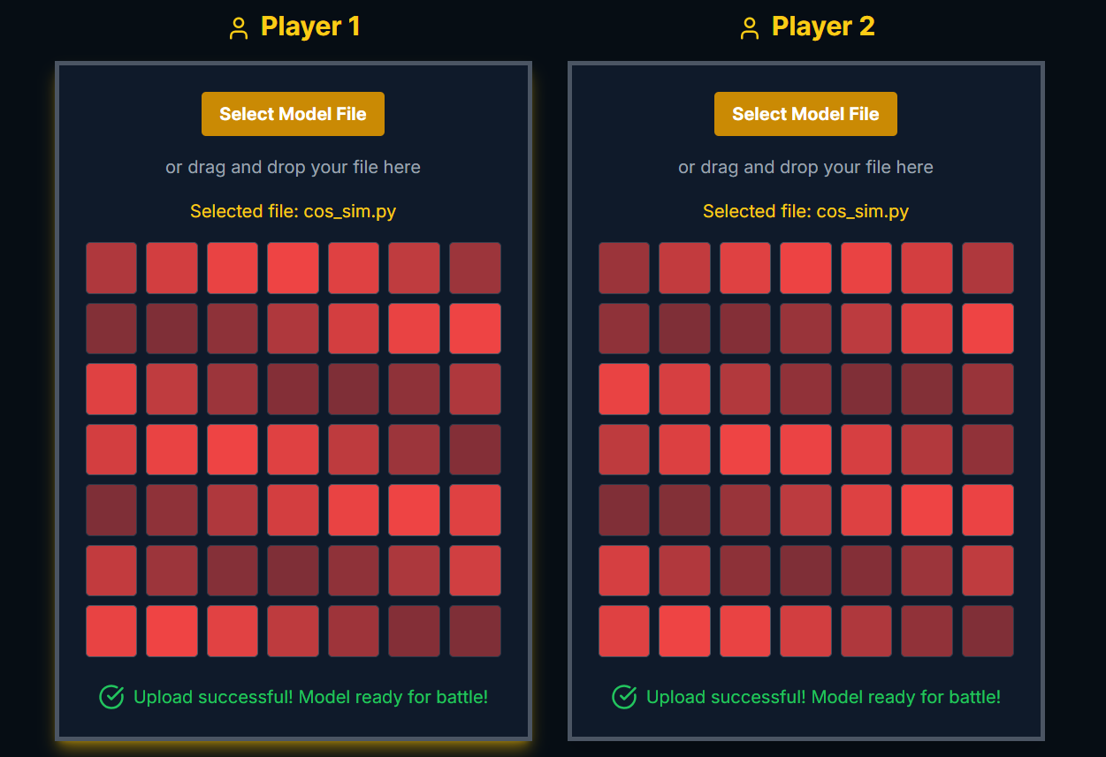
Test your Bot
Individual 1v1
Layout
Uploaded via
Online Site

Slide 7
Networking Demo
Player
Player
Player
Server
This demo will be a showcase of a prototype of our networking software. Right now, it shows how the server will attempt to fill games with players at regular intervals. The number of players in each game is easily configurable.
Player
Player
Player

Slide 8
What is in the Live Demo?
Game Logic Demo
AI Model Upload
Network Demo
A live look at Logic
Seeing the 1v1 Visuals
Loading on Live Network
Watching a live demo of 2 bots playing in the python script.
Watching a live upload of 2 example Bots that will battle 1v1.
Running the python program and opening a browser link.

Slide 9
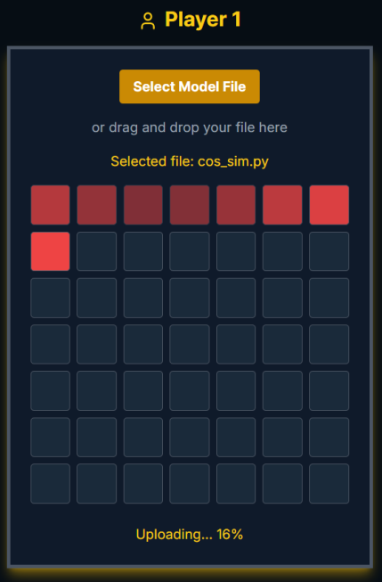
Live Demo
Present the Live Demo.

